Slide 1
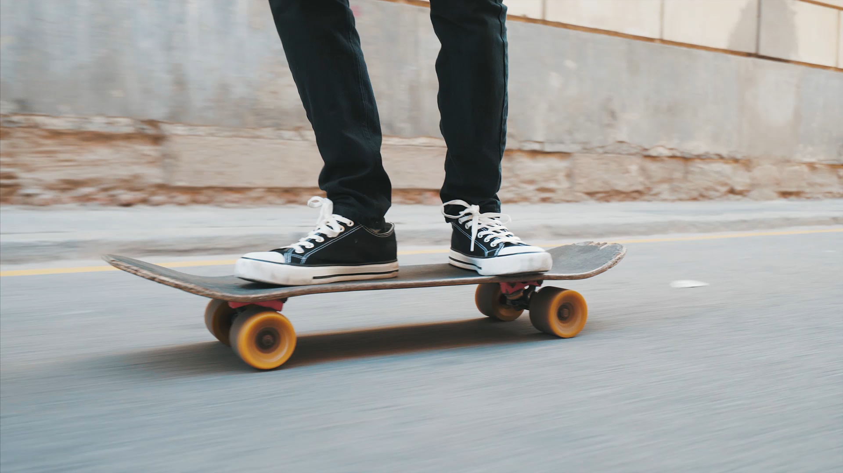
Subway Surfers
By: Winston Roller

Slide 2
Objective
The goal of this project was the recreate the game Subway Surfers using digital logic. You move along the bottom row of a 4x4 LED display and dodge obstacles coming down at you by moving left and right and collect coins to increase your score. The obstacle and coin placements would be predetermined. The game also loops, so you could go forever if you don’t lose by colliding with an obstacle.
What the project does currently is everything above except the point system. You can move around and dodge obstacles but there are no coins or a score.

Slide 3
Instructions
There are 3 usable buttons for the game. The left most button (button with the brown wire) is the start button. The buttons that move you left and right are the last 2 buttons from the start button. You first must click the start button and initialize the game by loading the player and starting the timer for the obstacles. Once you start you can use the left and right buttons to move around. You must be careful, as if you move to far to the left or right you get eaten by a dragon and you must reset the game by clicking the start button. The player is represented as a green LED along the bottom row and the obstacles are represented as red LEDs. So your goal is to make the green LED dodge the red LEDs. If you collide with a red LED, you will lose the game, and it will reset.

Slide 4
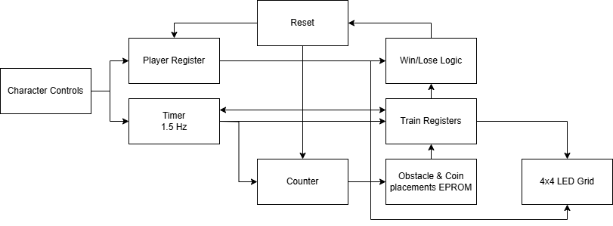
What’s built Block Diagram

Slide 5
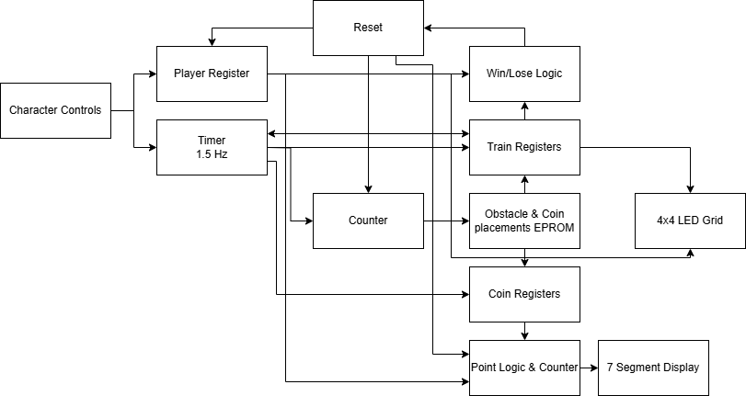
Goal Block Diagram

Slide 6
Schematic

Slide 7
Design
For the player to move, I needed 2 buttons. One to move left and one to move right. These need to control the S

